Slide 1
Beauty and the Feast
Insulin's effect on perceived attraction
Madi Price, Maria Angelina Bekhit, Lydia Speece and Sam Roberts

Slide 2
Introduction

Slide 3

Can a Sugar Rush Make someone look like a 10?

Slide 4
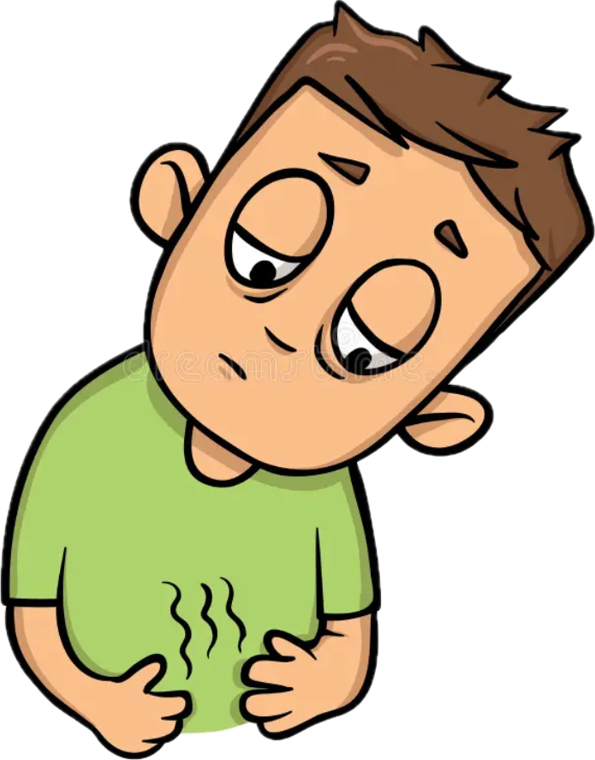
What do we Already Know ?
Hunger and glucose availability alter aesthetic judgments of faces and bodies. (Cazzato et al., 2022)
Traditionally viewed as stable, but recent findings suggest it's physiologically modulated
Literature shows mixed findings on hunger’s effect on attraction = no effect of hunger (Boothroyd et al., 2019 )

Slide 5
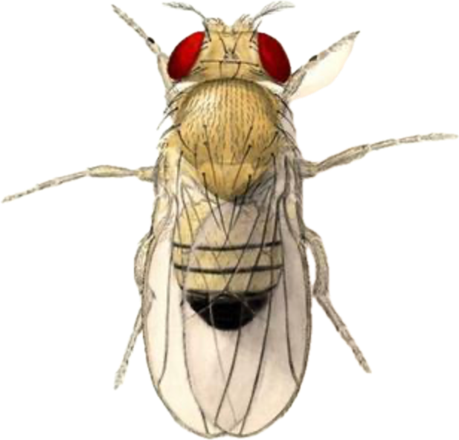
Not me, You say?
Drosophila (fruit flies)
Starved females exhibited increased attraction to cVA, vs. fed females showed reduced sensitivity.
One of many common hormones in all these studies : Insulin

Slide 6
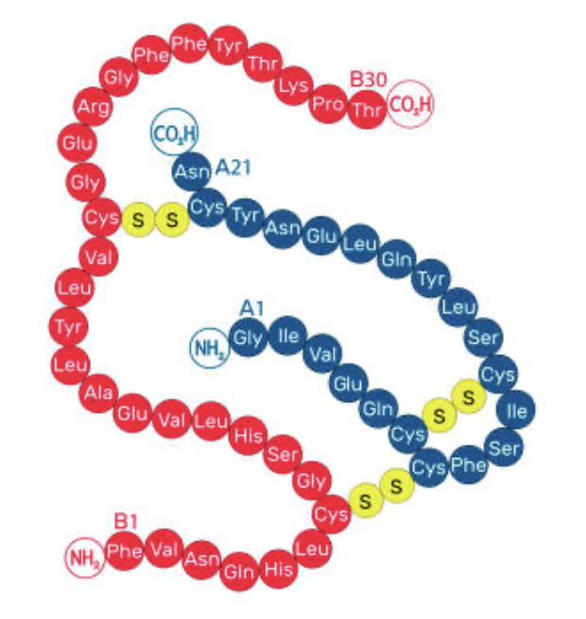
Insulin
Influences cognition, behavior, and reward sensitivity (Kullmann et al., 2020)
Main function is to regulate blood glucose levels by promoting glucose uptake into cells for energy/storage.
First hormone in line whenever a meal is ingested.
A need to investigate if this hormone had an impact on previous literature

Slide 7
Methods

Slide 8
Participants
All students from Belmont University
Screened for
People with diabetes type 1 and 2
People who had eaten before study
Excluded
People who didn't consent to have their DNA used
People who didn't follow the directions properly
Recruited through Sona = 25
Recruited through word of mouth = 8
total number after exclusions = 30

Slide 9
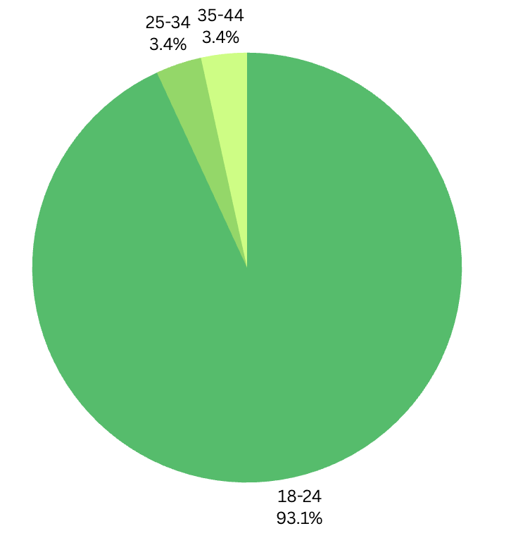
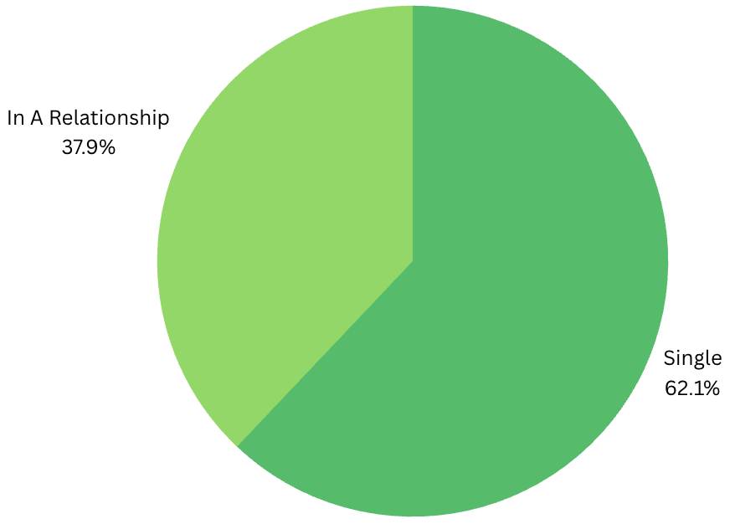
Ages:
18-24 years (28)
25-34 years (1)
35-44 years (1)
Relationship Status:
Single (18)
In a Relationship (12)

Slide 10
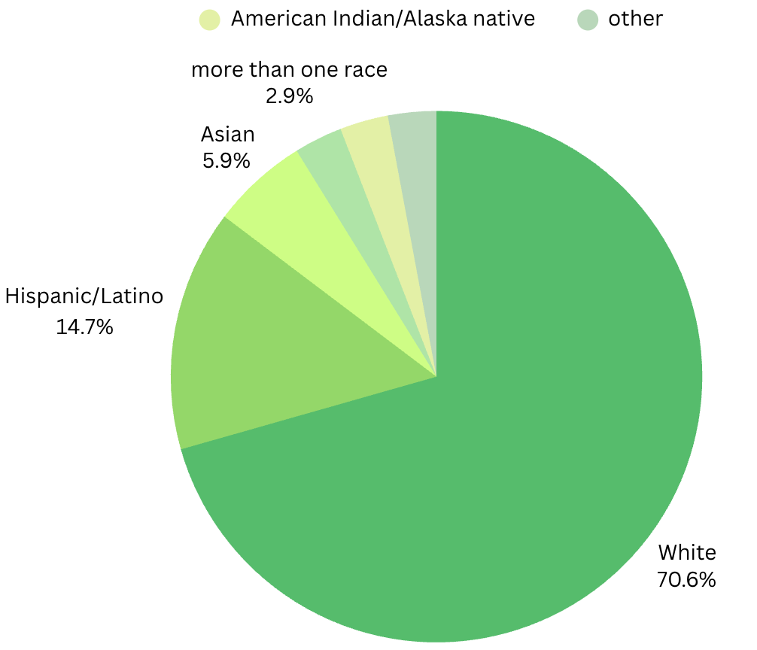
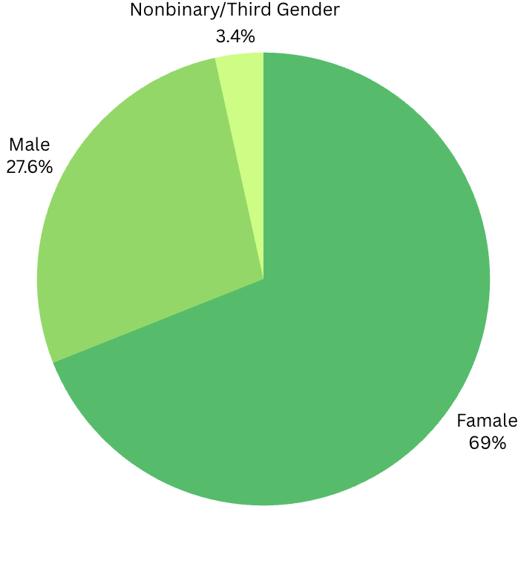
Race:
White (25)
Spanish, Hispanic, or Latino Origin (5)
Asian (2)
American Indian or Alaska Native (1)
More Than One Race (1)
Other (1)
Gender:
Female (21)
Male (8)
Nonbinary / Third Gender (1)
Cisgender (29)
Transgender (1)

Slide 11
Independent Variable:
Sprite for an insulin spike
Dependent Variable:
Insulin Concentration
&
Attraction

Slide 12
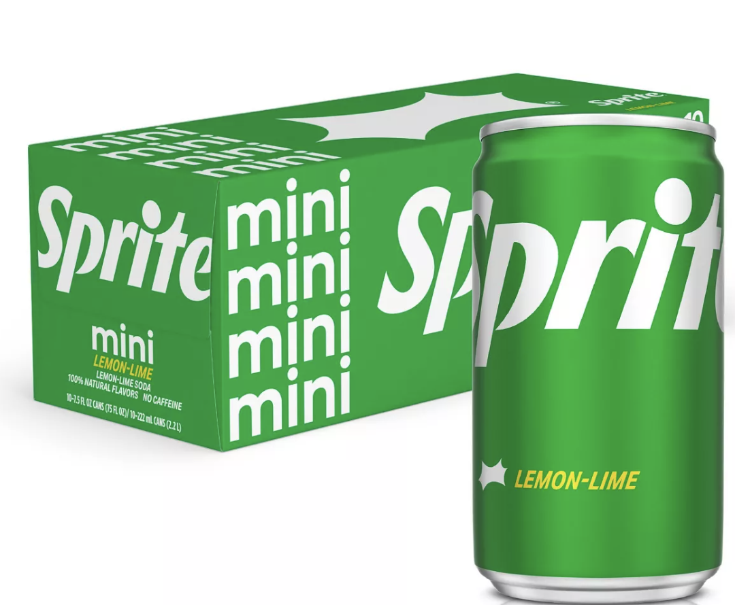
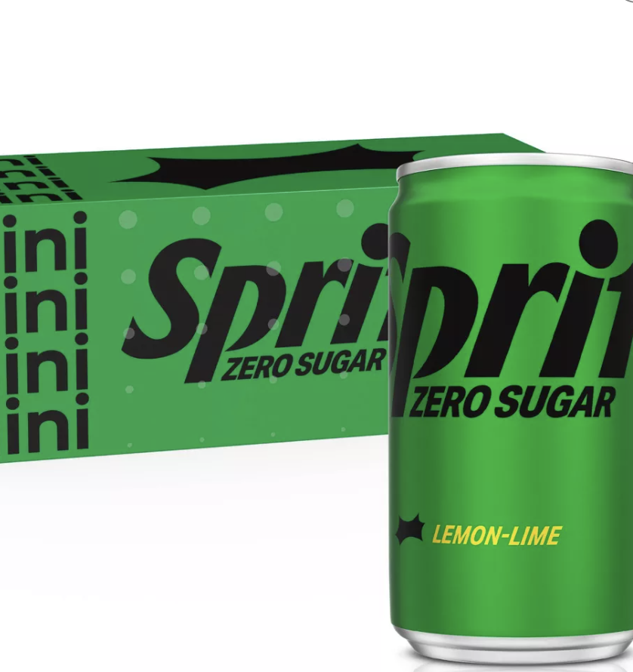
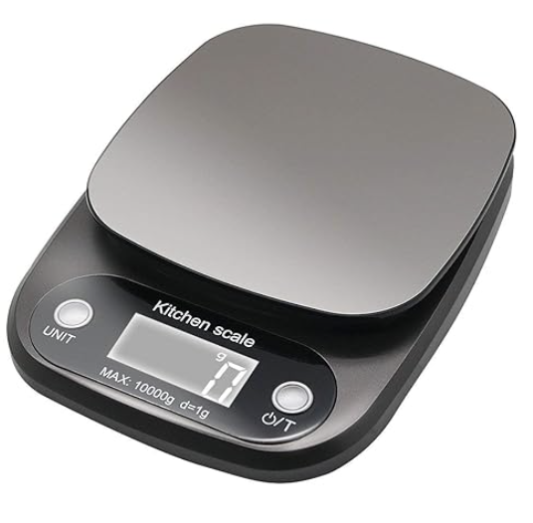
Insulin measurement
Insulin group
15 people got 175mL of Sprite
Hoping for an insulin spike
Control group
15 people got 175mL of Sprite 0
Hoping for no insulin spike

Slide 13
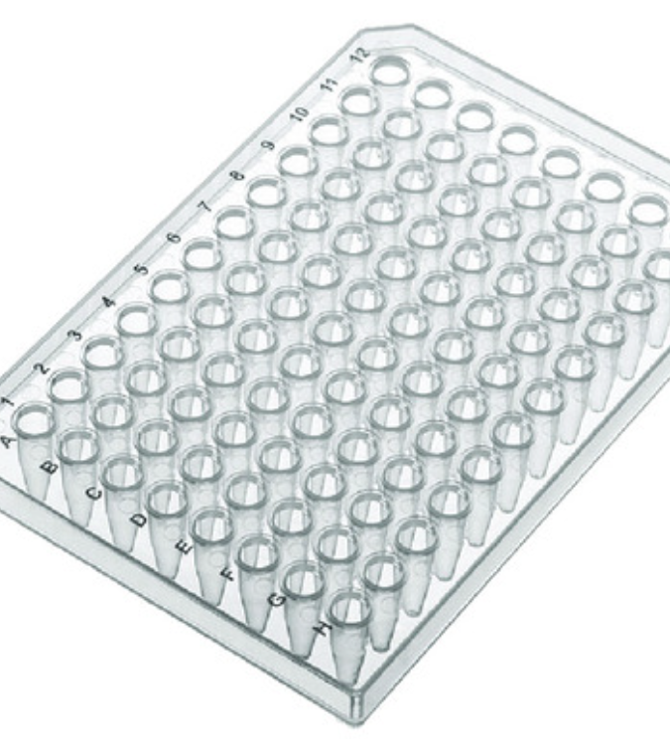
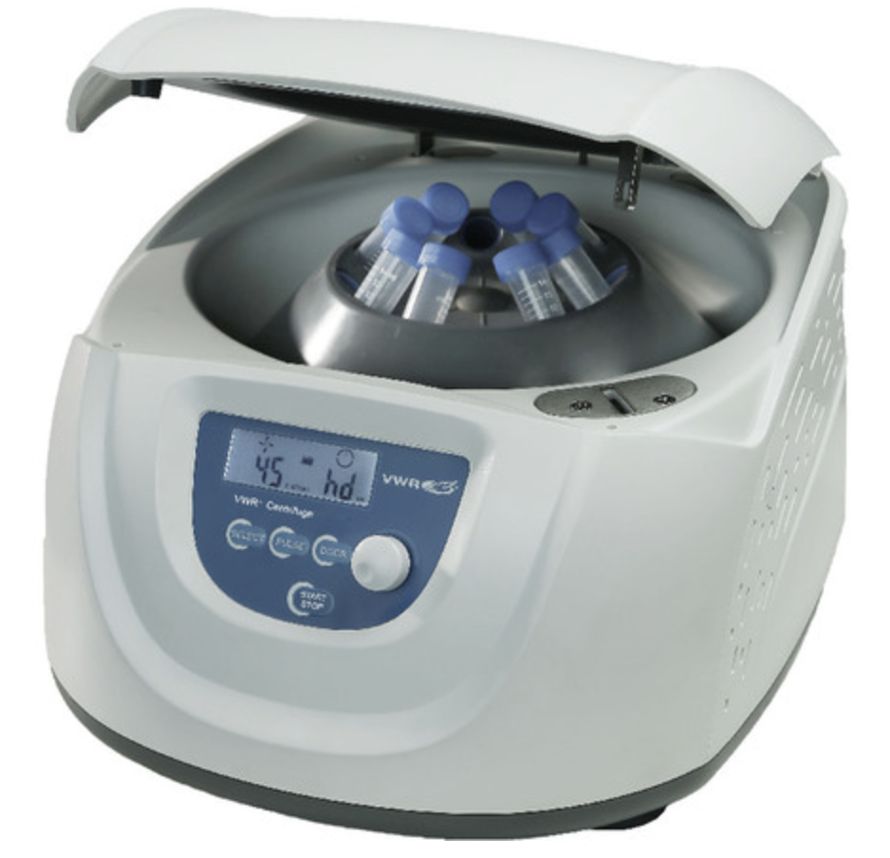
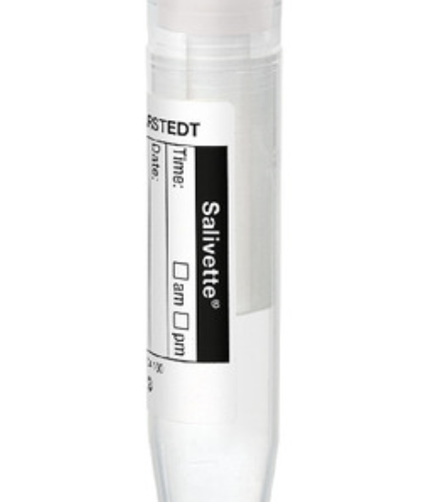
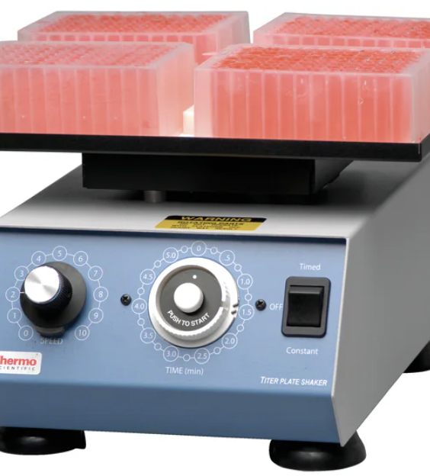
Insulin measurement
Salavat (300mL)
Centrifuged at 1500xg
96 well plate
plate rotator at 500rpm

Slide 14
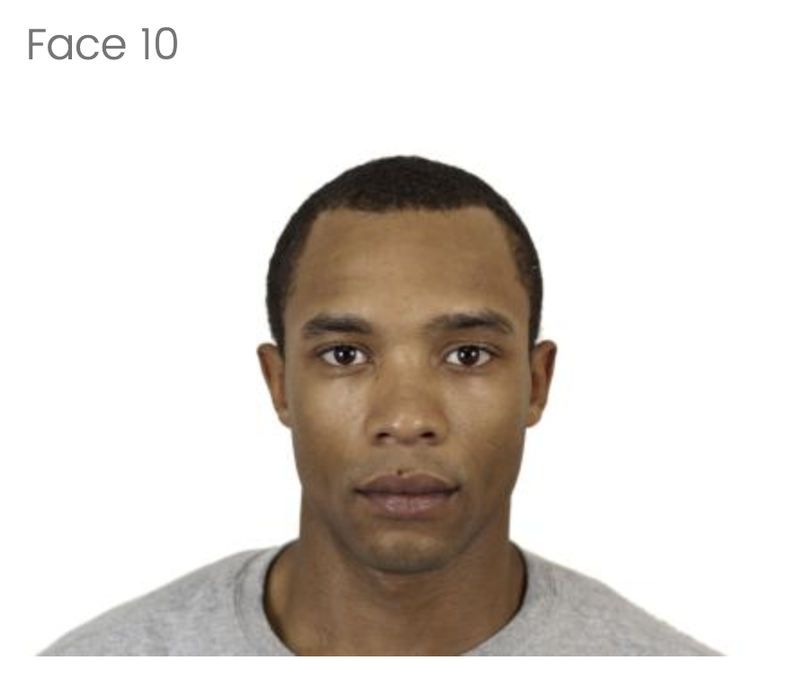
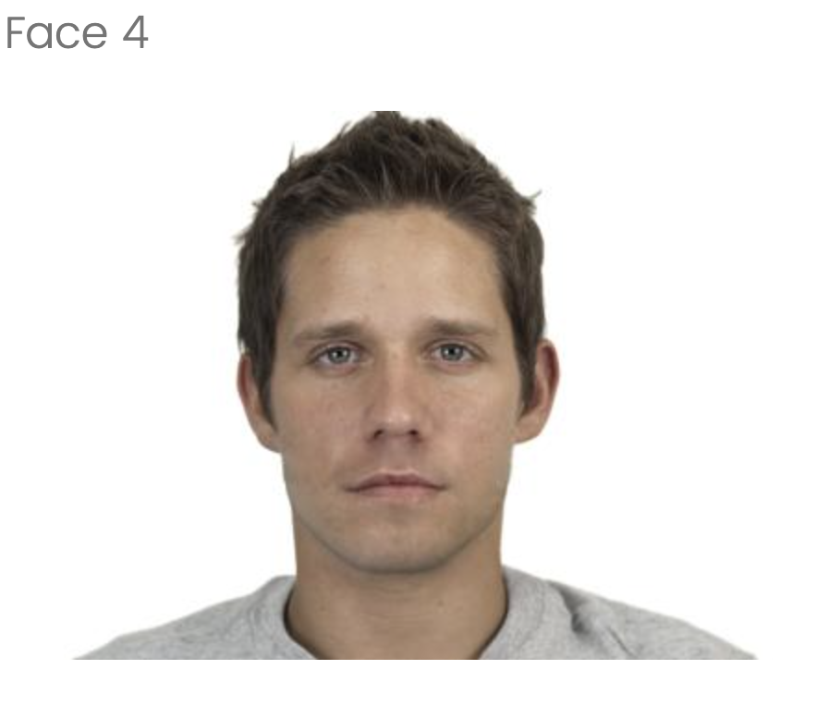
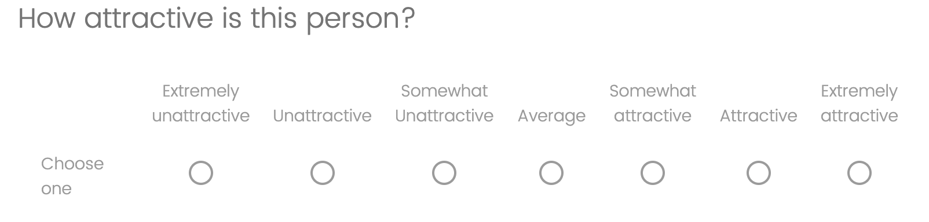
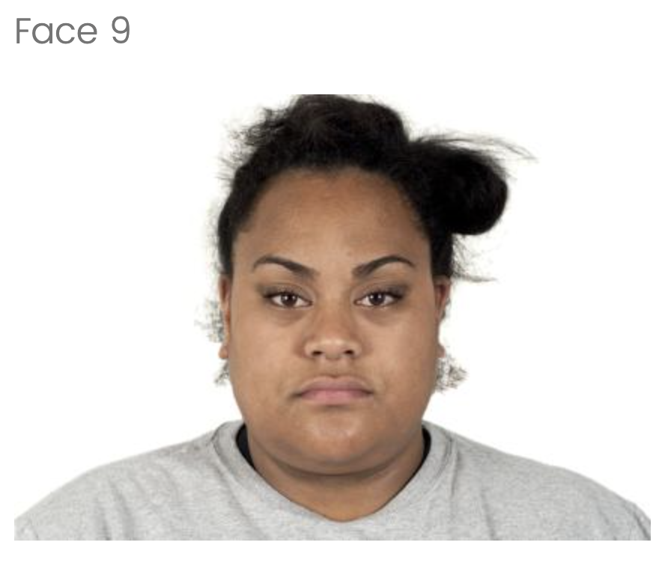
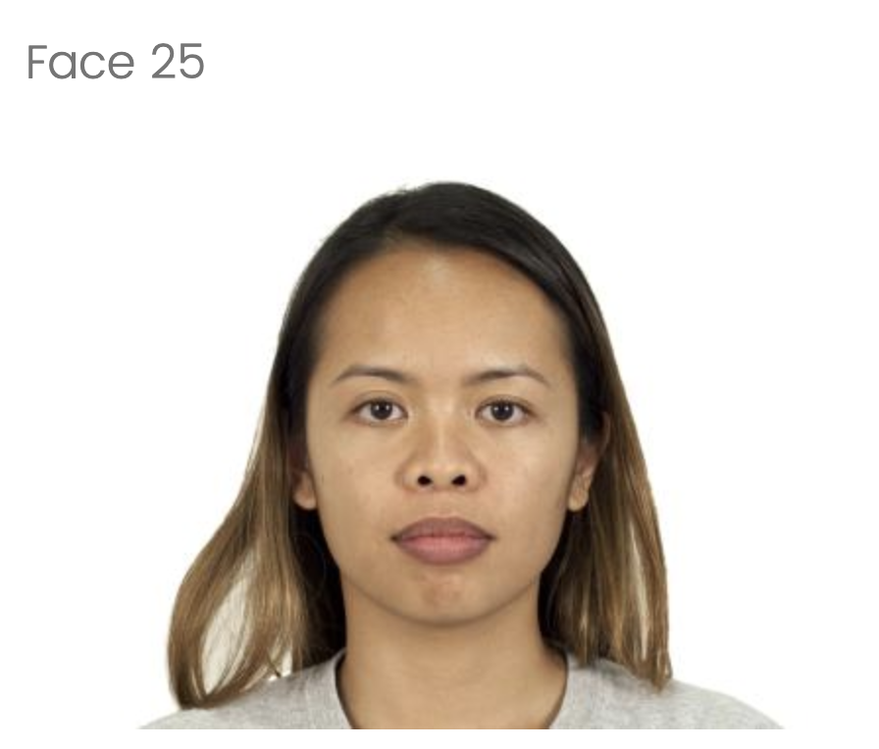
Attraction Ratings
40 faces
20 men & 20 woman
5 men, 5 women of White, Black, Hispanic, & Asian races
7-point Likert scale
For a baseline
Rank the first 20 faces
After 15-minute wait time
Rank the other 20 faces

Slide 15
Results

Slide 16
Mixed anova
Results were imported into Google Colab and evaluated using the Python programming language.
Additional resources like StatsModels, Seaborn, and Matplotlib were used to analyze statistics and visualize data.
Using a 95% CI with significance level ⍺ = 0.05

Slide 17
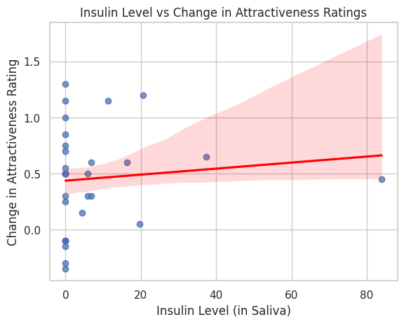
Insulin Level vs Change in Attraction: A Linear regression
P-value: 0.443 > 0.05
R-squared: 0.01
Significant ❌
There is not enough evidence to suggest that insulin will predict a change in participants’ attraction ratings.
Notes:
1 percent of the variability in attractiveness ratings is ascribed to insulin levels
Correlation coefficient is 0.0027
A ton of zeros bc assay was unreliable, transition into the story I want to tell

Slide 18
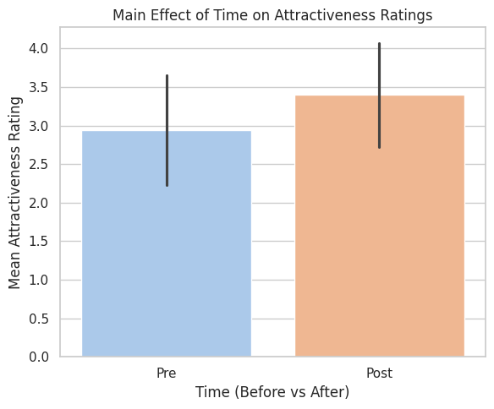
Time
P-value: 7.14e-06 < 0.05
Significant ✅
There is a significant effect of time on ratings of attraction.

Slide 19
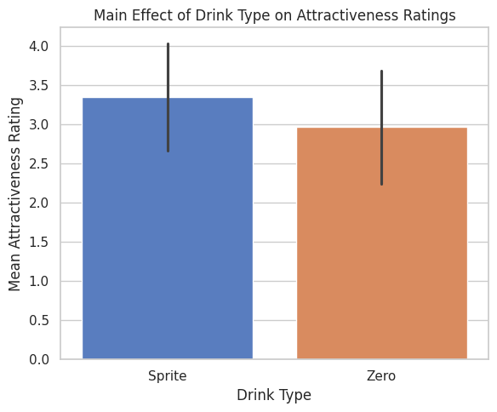
Drink type
P-value: 0.0055 < 0.05
Significant ✅
There is a significant difference in attraction ratings in the people who drank Sprite vs. the ones who drank Sprite Zero.
Overall difference NOT a difference over time.

Slide 20
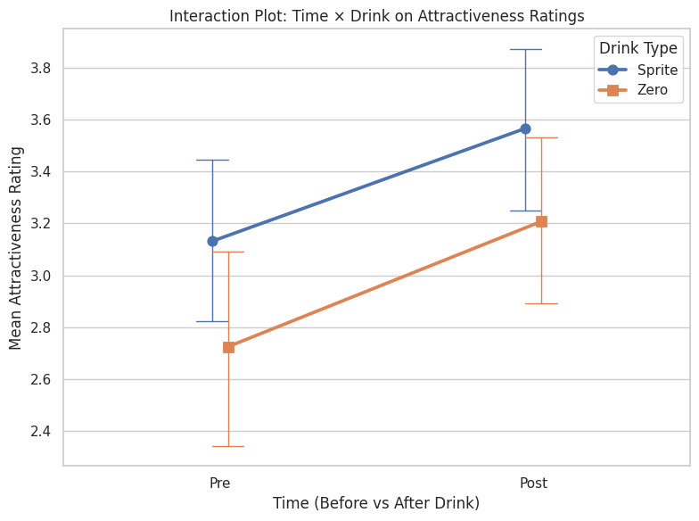
Time X drink type interaction
MAIN HYPOTHESIS
- Does a manual change in insulin increase ratings of attraction?
P-value: 0.776 > 0.05
Significant ❌
There is not enough evidence to suggest that the interaction between time and type of drink received will influence ratings of attraction.
Both groups changed similarly.

Slide 21
Discussion

Slide 22
the results conclude an incorrect hypothesis
Time effect is real → Participants rated faces as more attractive in round two.
Sprite effect is misleading → Sprite group rated significantly higher, but they already started higher.
Interaction effect is key → The ratings increase from test 1 to test 2 was the same across groups, so Sprite didn’t amplify the effect.

Slide 23
If sprite didn't cause the Rating increase between tests, what did?
Improved Processing Fluency
Cognitive Averaging Effect

Slide 24
Processing Fluency Boosted Ratings
The easier it is for our brain to process something, the better we are at it
Greater task familiarity leads to cognitive ease
Task familiarity promotes higher scores and ratings
Reber et al. (2004)

Slide 25
Cognitive Averaging Effects
Test 1 may have shaped an internal attractiveness bias
Implicit face averaging from the 1st test
Established subconscious bias → Generalized rating inflation
Langlois et al. (1990)

Slide 26
Limitations
Individual variability in insulin sensitivity (e.g. diet, lifestyle, routine, ect.)
Salivary insulin levels may not reflect brain insulin activity accurately

